Slide 1

AP Statistics Final Project
Presentation
Yichen Tong, Ziang Cui, Tianyi Jia
G12

Slide 2
Topic
A Research on How to Effectively Utilize Academic and Social Resources in Universities and Colleges for New Students.

Slide 3
CONTENTS
目
1
Introduction
录
2
Procedure
3
Research and Summary
4
Discussion and Conclusion

Slide 4
1
INTRODUCTION

Slide 5
Introduction
Universities offer abundant resources for students to ensure their better life. It’s important to learn how to comprehensively investigate and master useful information. As senior students of the class of 2023 are graduating and beginning their college life this year, they want to quickly adapt to a new life and effectively cope with coming, challenging problems in life to become better while they are studying their four years of undergraduate programs. Our group is investigating effective methods for prospective students to conduct research on utilizing academic and even social resources and connections at universities, on campus or on websites. Therefore, this report would be able to show the results of our group that we focus on researching and summarizing practical methods and tips for fully exploiting existing resources at schools, either on campus or through online websites, and taking one of the most famous universities as an example.

Slide 6
2
PROCEDURE

Slide 7
Procedure
First of all we confirm our overall research topic, then we learn about relevant fundamental knowledge about effective research methods and useful data collection tools online, and visit the websites of universities to figure out homogeneity and differences in academics like curriculum, facilities and faculty research/projects and social resources like public engagements, advisors and career development assistance.
Then, we take the universities/colleges, Cornell University as an example to specifically illustrate what are Academic/Social resources and how to collect those information for first-year students. After collecting all the required information, we start to write a complete outline of the paper and add information we’ve researched into different categories to show tips we summarized.

Slide 8
3
RESEARCH
&
SUMMARY

Slide 9
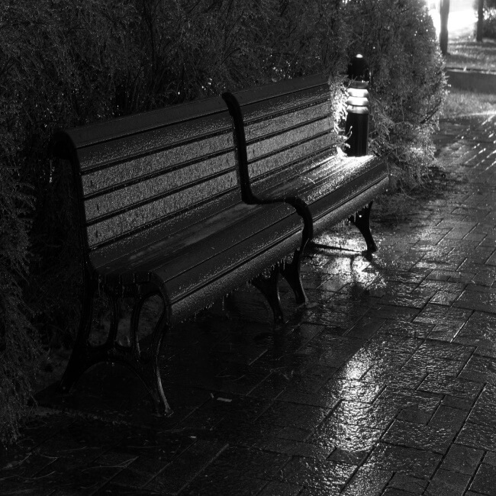
Research & Summary
Academic
Social
Fields of Study/Curriculum
Public Engagement
Library & Laboratory Facilities
Advisor
Faculty Research
Career Center

Slide 10
4
DISCUSSION
&
CONCLUSION

Slide 11
Discussion & Summary
From what has been shown above, we have summarized several important points for prospective college students to conduct research on utilizing academic, including curriculum, library and laboratory, faculty research and even social resources like public engagement, advisor and career center at universities. By learning these effective tips and methods, students can better adapt into the university life and easily achieve a good balance in their study life.

Slide 12
Reference
1.15 Steps to Good Research | Georgetown University Library. (n.d.). https://library.georgetown.edu/tutorials/research-guides/15-steps
2.Publisher, A. R. a. R. O. O. (2015, October 27). 11.4 Strategies for Gathering Reliable Information. Pressbooks. https://open.lib.umn.edu/writingforsuccess/chapter/11-4-strategies-for-gathering-reliable-information/
3.2023 Best Colleges in America. (n.d.). Niche. https://www.niche.com/colleges/search/best-colleges/
4.Office of Web Communications, Cornell University. (n.d.-a). Academics | Cornell University. Copyright (C) 2023 Cornell University. https://www.cornell.edu/academics/
5.Cornell Student Essentials. (n.d.). https://www.studentessentials.cornell.edu/
6.Office of Web Communications, Cornell University. (n.d.-c). Research | Cornell University. Copyright (C) 2023 Cornell University. https://www.cornell.edu/research/
7.Office of Web Communications, Cornell University. (n.d.-b). Public Engagement | Cornell. Copyright (C) 2023 Cornell University. https://www.cornell.edu/engagement/
8.Home Page | Facilities and Campus Services. (n.d.). https://fcs.cornell.edu/

Slide 13
Thank You For Listening

